Slide 1
Chapter 1
The Foundations: Logic and Proofs
1.1 Propositional Logic
1.2 Applications of Propositional Logic
1.3 Propositional Equivalences
1.4 Predicates and Quantifiers
1.5 Nested Quantifiers
1.6 Rules of Inference
1.7 Introduction to Proofs
1.8 Proof Methods and Strategy

Slide 2
Classification of Compound Propositions
Tautology : compound proposition that is always true
Contradiction : compound proposition that is always false.
Contingency: compound proposition that is neither a tautology nor a contradiction.
Examples:
    p ∧ ¬p
    p ∨ ¬p
    p ∨ ¬q
-- Contradiction
-- Tautology
-- Contingency

Slide 3
Logical Equivalences
【 Definition】The compound propositions p and q are called logically equivalent if p ↔ q is a tautology.
Notation: p ≡ q or p ⇔ q
    Example: Show that ¬(p ∨ q) and ¬ p ∧ ¬q are logically equivalent.
Solution:
¬(p ∨ q) ≡ ¬ p ∧ ¬q
p | q | ¬ p | ¬ q | p ∨ q | ¬ (p∨q) | ¬ p∧¬q
T | T | F | F | T | F | F
T | F | F | T | T | F | F
F | T | T | F | T | F | F
F | F | T | T | F | T | T
De Morgan law

Slide 4
Logical Equivalences
Show p ≡ q
Using truth tables
  Construct truth tables for p and q
  Check the truth values of p and q to see if they agree
Using already-proved equivalences
  Keep replacing a compound proposition with its equivalent proposition until achieving the goal
Easy but time-consuming when the number of variables is large
Just like what we do in Algebra

Slide 5
Logical Equivalences
Name | Equivalence
Identity laws | p ∧ T ≡ p p ∨ F ≡ p
Domination laws | p ∨ T≡ T p ∧ F ≡ F
Idempotent laws | p ∨ p ≡ p p ∧ p ≡ p
Double negation law | ¬(¬p) ≡ p
Commutative laws | p ∨ q ≡ q ∨ p p ∧ q ≡ q ∧ p
Associative laws | (p ∨ q) ∨ r ≡ p ∨ (q ∨ r) (p ∧ q) ∧ r ≡ p ∧ (q ∧ r)
Distributive laws | p ∨ (q ∧ r) ≡ (p ∨ q) ∧ (p ∨ r) p ∧ (q ∨ r) ≡ (p ∧ q) ∨ (p ∧ r)
De Morgan's laws | ¬(p ∧ q) ≡ ¬ p ∨ ¬ q ¬(p ∨ q) ≡ ¬ p ∧ ¬ q

Slide 6
Logical Equivalences
Name | Equivalence
Absorption laws | p∨ ( p ∧ q) ≡ p p ∧ ( p ∨ q) ≡ p
Negation laws | p ∨ ¬ p ≡ T p ∧ ¬ p ≡ F
Implication law | p → q ≡ ¬ p ∨ q
Equivalence law | p ↔ q ≡ (p → q) ∧ (q → p)

Slide 7





Logical Equivalences
Examples:
Show that ¬( p∨(¬ p ∧ q)) and ¬p ∧¬ q are logically equivalent.
Solution:
by the De Morgan’s law
by the De Morgan’s law
by the double negation law
by the distributive law
by the negation law
by the identity law

Slide 8


Logical Equivalences
Examples:
Show that is a tautology
Solution:

Slide 9


Logical Equivalences
Examples:
Show that and are not logically equivalent.
Hint:
To show these are not logically equivalent, we need only find one assignment of truth values to p, q, r, s for which the truth values of the two propositions differ.

Slide 10
Using De Morgan’s Laws
Use De Morgan’s laws to express the negation of “Mike has a cellphone and he has a laptop computer” and “Jim will go to the concert or Steve will go to the concert.”
Solution:
Mike does not have a cellphone or he does not have a laptop computer.
Jim will not go to the concert and Steve will not go to the concert.

Slide 11
Exercises
Find a compound proposition involving the propositional variables p, q, r that is true when exactly two of p, q, and r are true and is false otherwise.
Solution:
    p ∧ q ∧ ¬r
    p ∧ ¬ q ∧ r
    ¬ p ∧ q ∧ r
    ( p ∧ q ∧ ¬r ) ∨ (p ∧ ¬ q ∧ r ) ∨ (¬ p ∧ q ∧ r)

Slide 12
Exercises
The proposition p NOR q is true when both p and q are false, and it is false otherwise. The operator ↓ is called Peirce arrow.
(a) show that p ↓ p is logically equivalent to ¬ p
(b) show that (p ↓ q) ↓ (p ↓ q) is logically equivalent to p ∨ q

Slide 13
Propositional Satisfiability
A compound proposition is satisfiable if there is an assignment of truth values to its variables that make it true. When no such assignments exist, the compound proposition is unsatisfiable.
A compound proposition is unsatisfiable if and only if its negation is a tautology.
Examples:

Slide 14
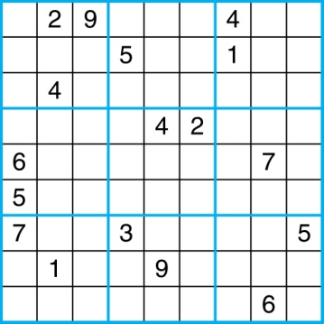
Sudoku
A Sudoku puzzle is represented by a 9×9 grid made up of nine 3×3 subgrids, known as blocks. Some of the 81 cells of the puzzle are assigned one of the numbers 1,2, …, 9.
The puzzle is solved by assigning numbers to each blank cell so that every row, column and block contains each of the nine possible numbers.

Slide 15
Encoding as a Satisfiability Problem
Let p(i, j, n) denote the proposition that is true when the number n is in the cell in the ith row and the jth column.
There are 9×9 × 9 = 729 such propositions.
In the sample puzzle, p(5,1,6) is true, but p(5, j, 6) is false for j = 2,3,…9

Slide 16
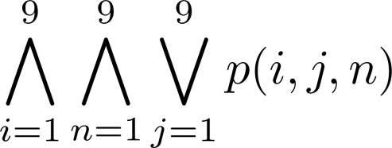
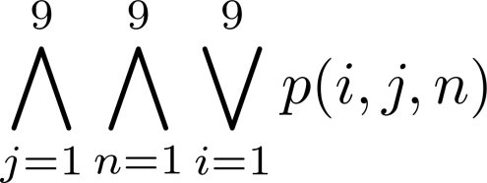
Encoding as a Satisfiability Problem
For each cell with a given value, assert p(i, j, n), when the cell in row i and column j has the given value.
Assert that every row contains every number.
Assert that every column contains every number.

Slide 17
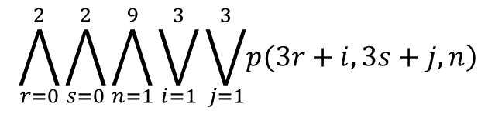
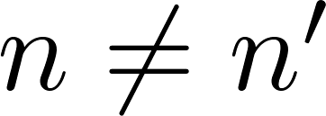
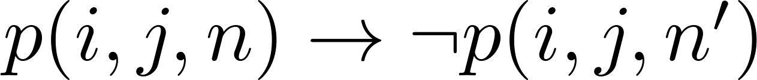
Encoding as a Satisfiability Problem
Assert that each of the 3 x 3 blocks contain every number.
Assert that no cell contains more than one number. Take the conjunction over all values of n, n’, i, and j, where each variable ranges from 1 to 9 and , of
Find an assignment of truth values to the 729 variables of the form p(i, j, n) that makes the conjunction of the above assertions true. Those variables that are assigned T yield a solution to the puzzle.

Slide 18
Homework
Due date: Mar. 9 (Tuesday)
Sec. 1.3 6, 8(a,b), 16(b), 36, 44, 55, 62

